Slide 1



Intelligent Abnormal Electricity Usage Detection
University: Dr. Subhash University (DSU)
Team Members:
Aryan Bhogayata (Team Leader)
Ananya Goswami
Ankit Dervaniya
Sakshi Fadadu
Kumbhani Vishva
Trainer Name: Rohit Bhadauriya
Team ID: S4F_CP_Team_54364
Link: https://github.com/aryanbhogayata/Abnormal-Electricity-Usage-Detection
Date: February 13, 2026

Slide 2
Dataset Overview
Dataset Description:
Source: Real-world smart meter data from Kerala, India (Kaggle).
Size: 10,800 records with 15 features.
Key Features: Actual_Energy(kwh), House_Area, Num_Occupants, Appliance_Score, Temperature, Humidity, and Abnormal_Usage (Target)
Data Preprocessing:
Cleaning: Removed "kWh" suffixes from energy columns to convert text to numeric values.
Handling Missing Data: Dropped rows with missing target values to ensure high-quality training data.
Feature Engineering: Extracted Month and Day_of_Week from the date column to capture temporal usage patterns.
Encoding: Applied One-Hot Encoding to categorical variables like Region_Code and Dwelling_Type.

Slide 3
Problem Statement
Brief Overview:
Electricity theft and meter tampering cause significant revenue loss for utility companies. Traditional manual inspection is slow and inefficient. This project aims to automate the detection of these anomalies using machine learning.
Key Objectives:
To build a robust ML model that identifies abnormal electricity consumption patterns.
To analyze the impact of household characteristics (e.g., area, occupants) on energy usage.
To provide a scalable solution for real-time anomaly detection in smart grids.

Slide 4
Methodology
Approach:
Data Collection & Cleaning: Processed raw CSV data to handle non-numeric characters and missing values.
Exploratory Data Analysis (EDA): Visualized correlations to identify that Actual_Energy and Usage_Deviation are key indicators.
Model Selection: Chose Random Forest Classifier for its ability to handle non-linear relationships and resistance to overfitting.
Training: Split data (80% train, 20% test) and trained the model on 100 decision trees.
Algorithms Used:
Random Forest Classifier: Selected for its high accuracy and interpretability (feature importance).
Evaluation Metrics:
Accuracy: Overall correctness of the model.
Precision & Recall: To ensure we minimize false alarms (flagging honest customers) while catching actual theft.
Source :
www.freepik.com/

Slide 5
Result
Model Performance:
Accuracy: 96.3%
Precision (Abnormal Class): 97%
Recall (Abnormal Class): 93%
F1-Score: 0.95
Source :
www.freepik.com/

Slide 6
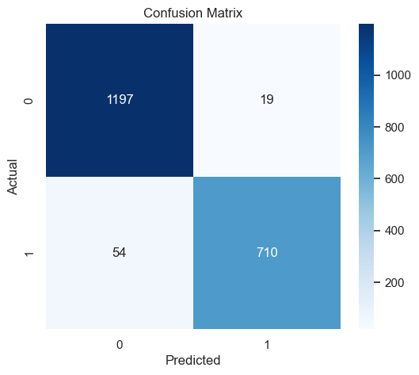
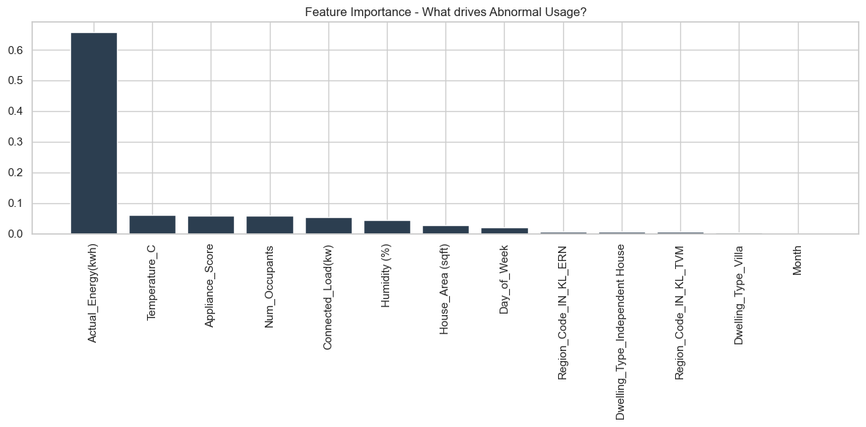
Graphs/Visualizations:
Shows 710 correct Abnormal detections vs. only 19 false alarms.
Actual_Energy(kwh) was the #1 predictor, followed by Connected_Load and Appliance_Score.

Slide 7
Discussion
Insights:
Abnormal usage is not just "high usage"; it is high usage relative to the house size and appliance score.
The model successfully learned that a small house with few appliances consuming massive energy is a strong signal for anomaly (likely theft or leakage).
Challenges Faced:
Data Quality: Initial columns contained mixed text/numbers ("12.82 kWh") requiring custom cleaning functions.
Feature Leakage Risk: We had to carefully exclude Usage_Deviation and Expected_Energy during training to ensure the model learned independently rather than just "reading the answer."
Source :
www.freepik.com/

Slide 8
Solution Impact
Sustainability Impact:
Reduces energy wastage by identifying faults or leakages early.
Promotes fair usage, ensuring that energy resources are distributed efficiently across the grid.
Practical Implementation:
Utility Dashboard: This model can be deployed on utility company servers to scan daily smart meter readings.
Alert System: Automatically flag accounts with >90% probability of abnormality for physical inspection, saving 1000s of man-hours.
Source :
www.freepik.com/

Slide 9

Conclusion
Summary:
  We successfully developed an Intelligent Abnormal Electricity Usage Detection system using a Random Forest Classifier. The model achieved 96% accuracy, proving that machine learning can effectively automate the detection of energy theft and meter anomalies.
Future Work:
  Integrate deep learning (LSTMs) to analyze time-series patterns (e.g., sudden spikes at specific times of day).
  Develop a mobile app interface for consumers to view their own usage health.
Source :
www.freepik.com/

Slide 10
References
Kaggle Dataset: Intelligent Abnormal Electricity Usage Dataset (Real-World).
Link: https://www.kaggle.com/code/sonalshinde123/abnormal-electricity-usage-detection/input
Scikit-Learn Documentation (Random Forest Classifier).
Pandas & NumPy Documentation for Data Preprocessing.
Project Code Repository: https://github.com/aryanbhogayata/Abnormal-Electricity-Usage-Detection
Dataset: Kaggle - Intelligent Abnormal Electricity Usage Dataset.

Slide 11
Thank You
Notes:
Thank You !!

